Slide 1
Duties of the State & Citizens
Key Stage 4

Slide 2

What is a State?
Who is a Citizen?

Slide 3


Components of a State:
- Permanent population
- Territory
- Sovereignty
- Government
- is governed by Constitution and LAWS.

Slide 4
Civics & Citizenship
Civics: the study of government and the rights and duties of citizens.
Citizenship: the legal status of being a citizen, granted by birth or naturalisation, giving the citizen certain rights and responsibilities.
Citizen: a person who is a member of a certain country or city, who is granted certain rights and privileges because of this, and is expected to act responsibly.
•Civics & Citizenship: the study of the rights and responsibilities of citizens and how the government works.

Slide 5
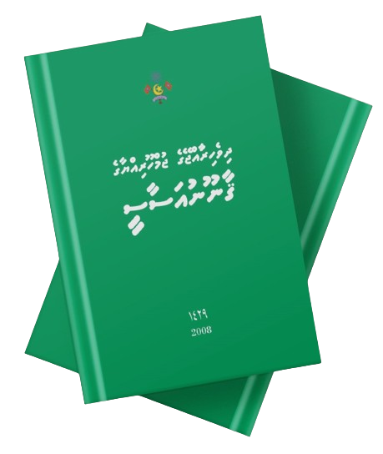
The Constitution of Maldives enumerates the fundamental rights and freedoms for every Citizen.

Slide 6
Duties of the State
  Chapter 2, Article 18:
  “It is the duty of the State to follow the provisions of this Constitution, and to protect and promote the rights and freedoms provided in this Chapter.”
To protect and preserve nature
To ensure every individual is equal by Law
To guarantee the social and economic rights

Slide 7
Chapter 2, Article 67:
The exercise and enjoyment of fundamental rights and freedoms is inseparable from the performance of responsibilities and duties
State
Citizen
RIGHTS
RESPONSIBILITIES
Notes:
Brainstorm the student about rights and responsibilities
The entitlements and duties as citizens.
Rights are freedoms that are protected legally.
Responsibilities are things you should do.
Unlike the USA, Maldives, does not have a national Bill of Rights that officially protects our rights

Slide 8
Our duties as Maldivian Citizens
protect the rights and freedom of others;
foster tolerance, mutual respect, and friendship among all people and groups;
contribute to the well-being and advancement of the community;
promote the sovereignty, unity, security, integrity and dignity of the Maldives;
respect the Constitution and the rule of law;
promote democratic values and practices in a manner that is not inconsistent with any tenet of Islam;
preserve and protect the State religion of Islam, culture, language and heritage of the country;
preserve and protect the natural environment
respect the national flag, state emblem and the national anthem
Notes:
, refer to the point number 8biodiversity, resources and beauty of the country and to abstain from all forms of pollution and ecological degradation;

Slide 9
to preserve and protect the natural environment, and to abstain from all forms of pollution
Rights and Responsibilities
?
Healthy and ecologically balanced envrironment
Notes:
Ask students from these two examples what could be the “right” and “the responsibility”

Slide 10
Activity
List five ways that the state shall help to improve the living of Citizens.
List five responsibilities we need to do to as citizens to protect and uphold the Constitution and the laws of the Maldives

